Slide 1

Object Oriented Programming - I

Slide 2
Recap...
File Handling
Modes
r | Read
w | Write
a | Append
Open a file
file.open(‘secret.txt’, ‘r’)
Read from file
file.read() - reads the whole file and returns it as a string
file.read(5) - reads first 5 characters and returns it as a string
file.readline()- reads one line of the file and returns it
Write to File
file.write(“Hello world!”) - write a string to the file

Slide 3
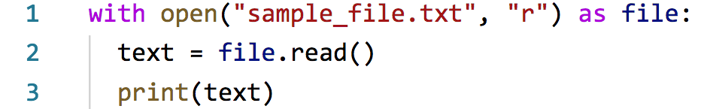
Recap...
File Handling
Closing a file
file.close()
OR

Slide 4
Recap...
Errors
Syntax error
Wrong code. E.g. a = 1+2 3 4
Compilation error
Also wrong code, but more subtle (e.g. printing a variable that is not defined)
Runtime error
Errors that happen when the code is run
Sometimes not the fault of the programmer (e.g. user enters text when number is asked)
Errors, when anticipated can be stopped before it stops the code

Slide 5
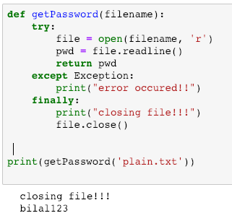
Recap...
Try...except

Slide 6
Procedural Programming
A style of writing computer programs or softwares using just functions
We have seen that so far (e.g add(2,6), sayhi() etc)
In large applications just functions makes things complicated to handle
So we also need another approach...

Slide 7
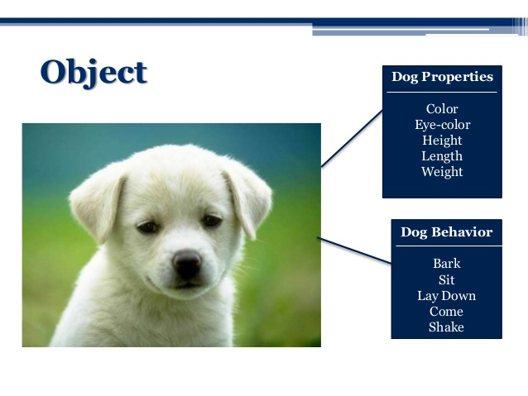
Object oriented Programming (OOP)
A different style of writing computer programs or softwares
Mimics real life objects

Slide 8
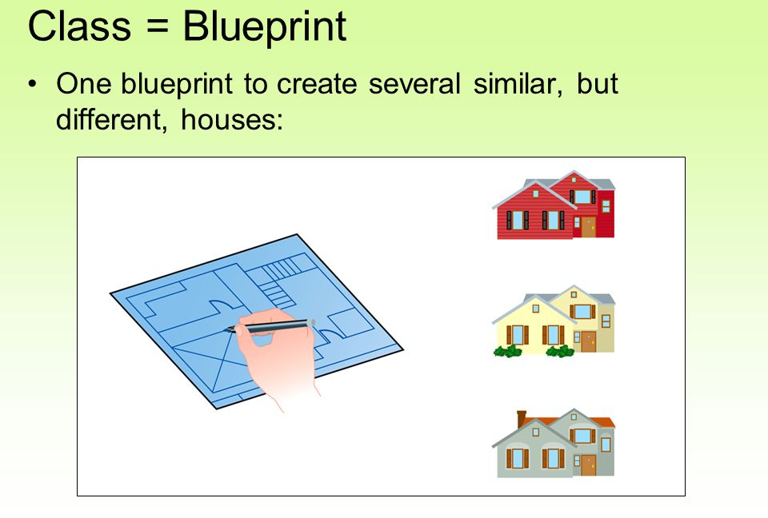
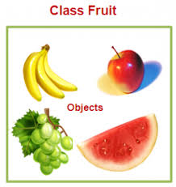
Object oriented Programming (OOP)
Classes and Objects

Slide 9
Object oriented Programming (OOP)
A class consists of:
Properties ⇒ Variables
Behavior ⇒ Methods or functions

Slide 10
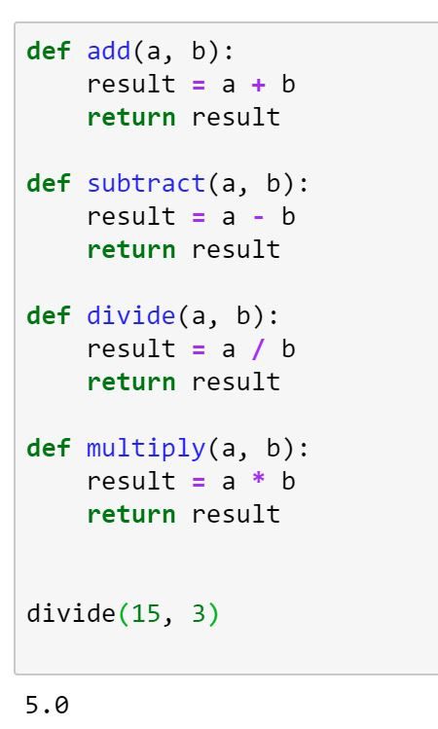
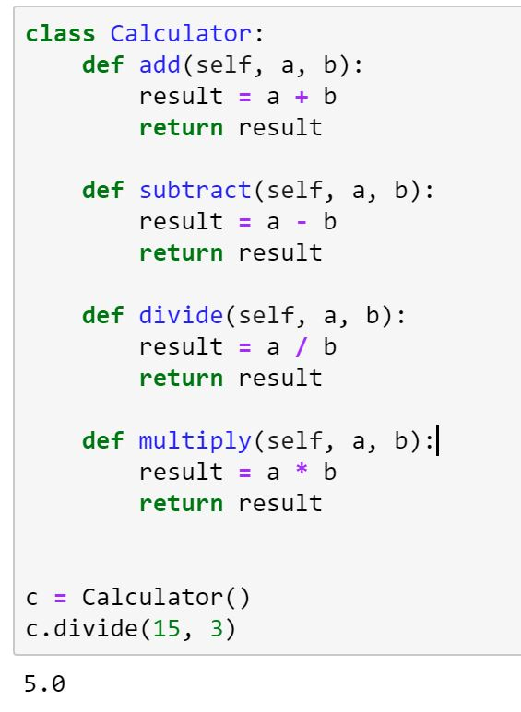
Object oriented Programming (OOP)
Difference:
Note:
This class only has behavior
This is the class which is used to create the object
Object created
Procedural
OOP

Slide 11
Object oriented Programming (OOP)
Dog class

Slide 12
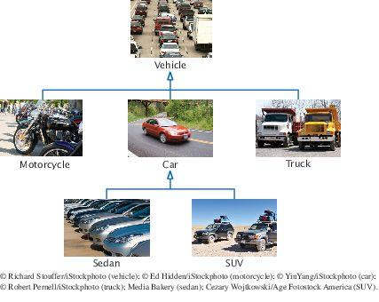
Object oriented Programming (OOP)
Inheritance
Parent-child relationship in classes

Slide 13
Composition
Inheritance ⇒ is_a relationship
Composition ⇒ has_a relationship

